Slide 1
Twitter sentiment analysis during the pandemic
Hanyan Wang, Yukun Shi, Yifei Li

Slide 2
Outline
Data
Model
Evaluation
Conclusion

Slide 3
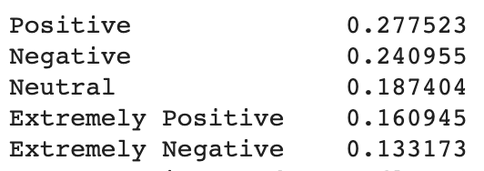
Data
https://www.kaggle.com/datatattle/covid-19-nlp-text-classification
Columns: 1.Location 2.Tweet At 3.Original Tweet 4.Label
41157 entries
Labels: Extremely Negative, Negative, Neutral, Positive, Extremely Positive

Slide 4
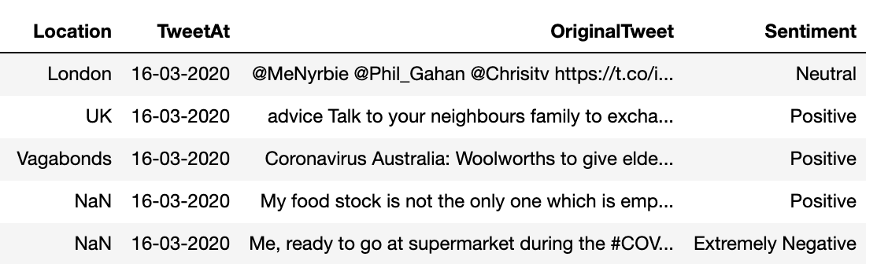

Slide 5
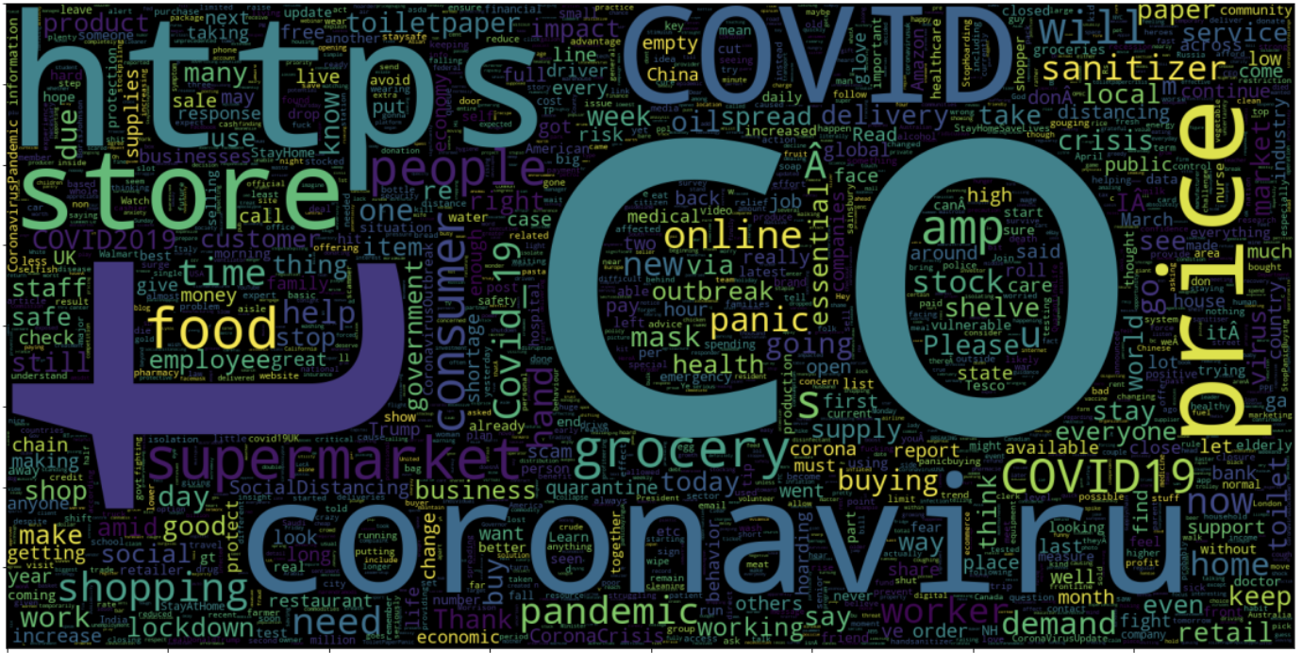
Data preprocess

Slide 6
Data preprocess
Extract tweets+labels
remove html tags, urls, mentions, digits
Tokenize
Pad sequence

Slide 7
Models
Basic Models:
Feedforward neural network
Inner approach: Bidirectional LSTM
Outer approach：Convolution layers + Dense layers
Advanced Models:
Bert
FastAI
Notes:
I’ll introduce our models to you.
Basicaly, We tried 5 models in this topic. 3 basic models: feedforward NN, biLSTM, convolutional NN and 2 advanced models bert and fast AI
~~~Next

Slide 8
Basic Models: Embedding layers
One key layer in neural networks to do NLP tasks is embedding layer.
Like a dictionary maps words to corresponding vectors.
[[4],[32],[67]] -> [[0.3,0.9,0.2],[-0.2,0.1,0,8],[0.1,0.3,0.9]]
A big weight matrix: vocabulary size x vector dim
In Base models vocabulary size is 35900 and output dim is 16
574k parameters contained.
Notes:
First I’ll talk about our basic models.
The most import thing in our all models is embedding layer.It’s a key layer in neural networks to do NLP tasks. It’s like a dictionary maps words to corresponding vectors.
For example, it will map word id four to vector (point three, point nine, point 2) and word id thirty two to (minus point two, point one, point right) and sixty seven to point one, point three and point nine
This dictionary is a big matrix, in our bas models the vocabulary size is about thirty six thousands and the output dim is sixteen, so there is about five hundred and seventy four parameters.
In base models, embedding layer has over half of the total parameters in each model.
~~~Next

Slide 9
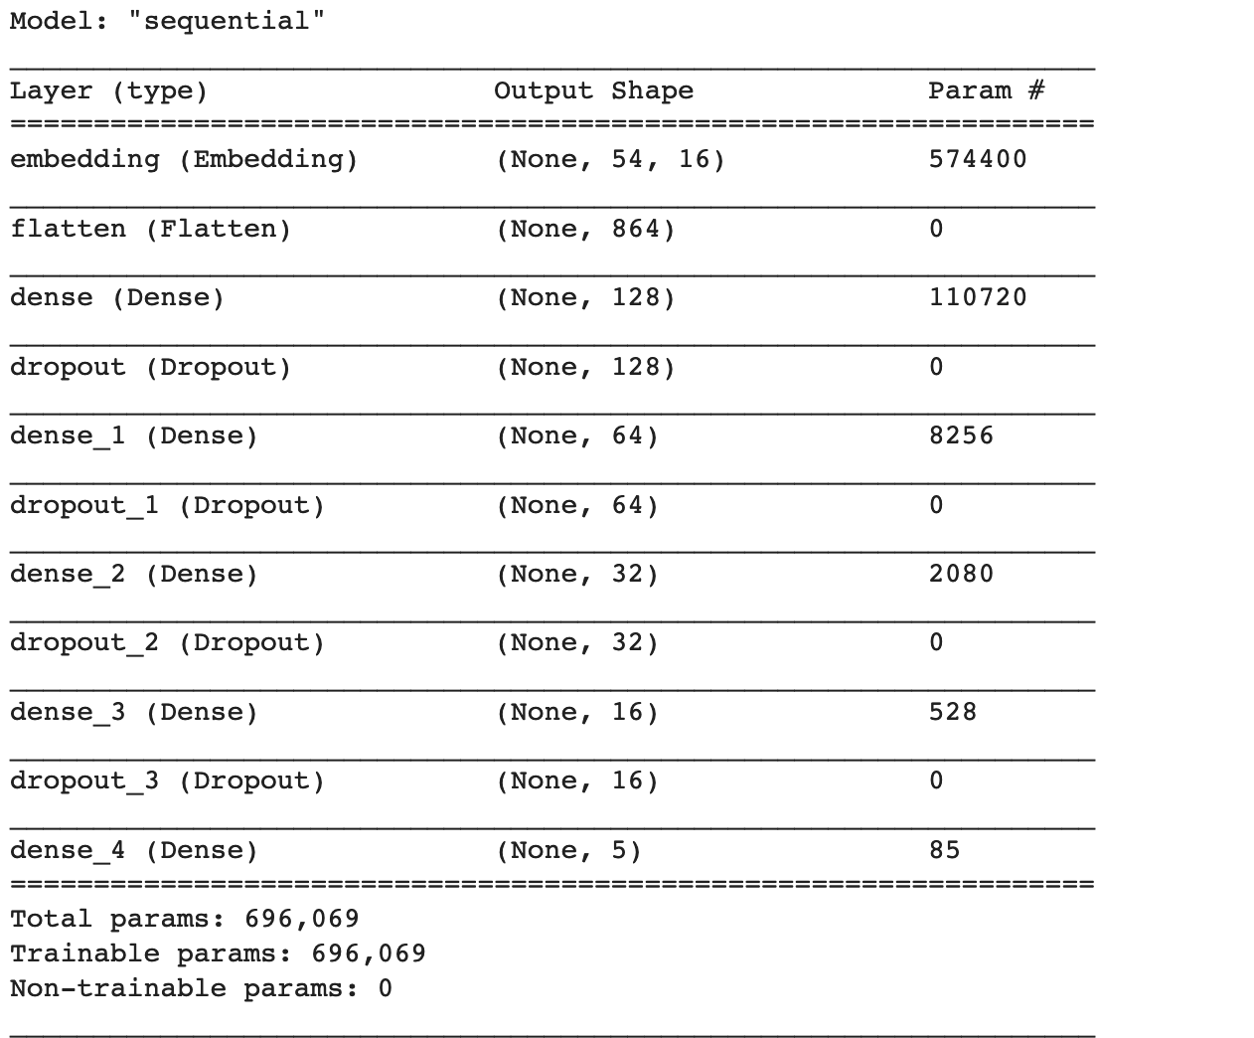
Feedforward neural network
4 extra Dense layers included:
Size:128, 64,32,16
Notes:
Now I will introduce our bas models.The baseline is feedforward neural network. We add 4 extra dense layers and the size if one hundred and twenty eight, sixty four, thirty two and sixteen.
This model has about seven hundred thousand parameters, which means it added about one hundred and twenty thousand parameters.
~~~ Next

Slide 10
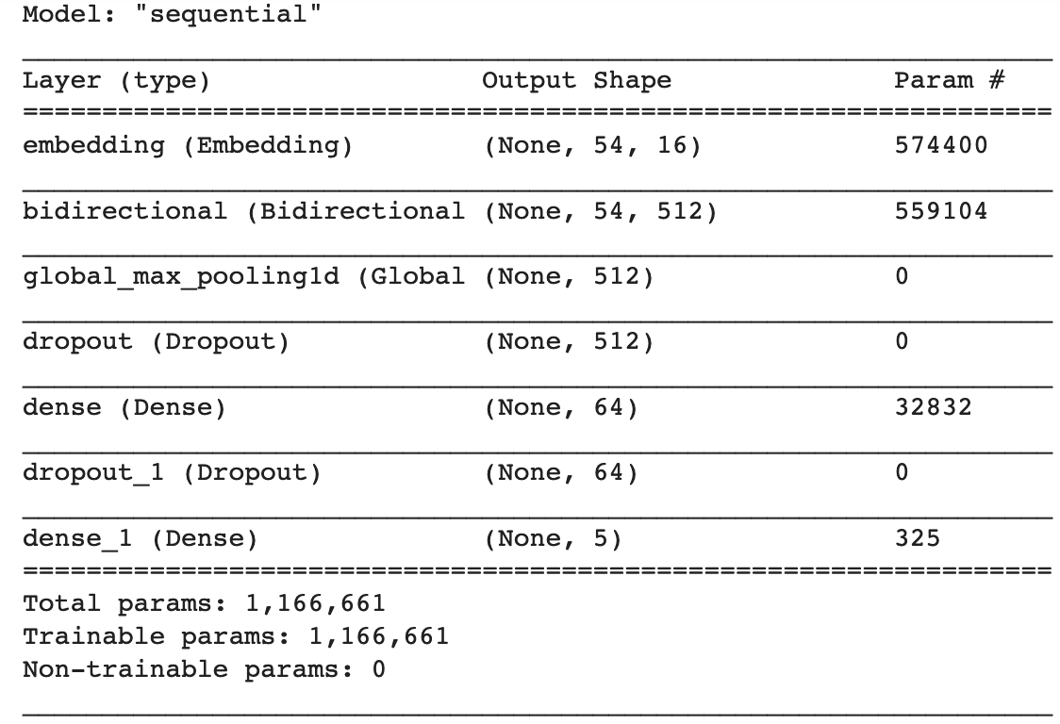
Bidirectional LSTM
A biLSTM + a dense layer of size 64.
Note: bi-LSTM contains a lot more parameters.
Notes:
Next model is kind of an inner approach: bidirectional LSTM. It contains a bidirectional LSTM layer, a max_pooling layer and a dense layer. Note that The bidirectional LSTM layer has a lot parameters. This model has 1M parameters in total and it is the most complex base model.
~~~~ Next

Slide 11
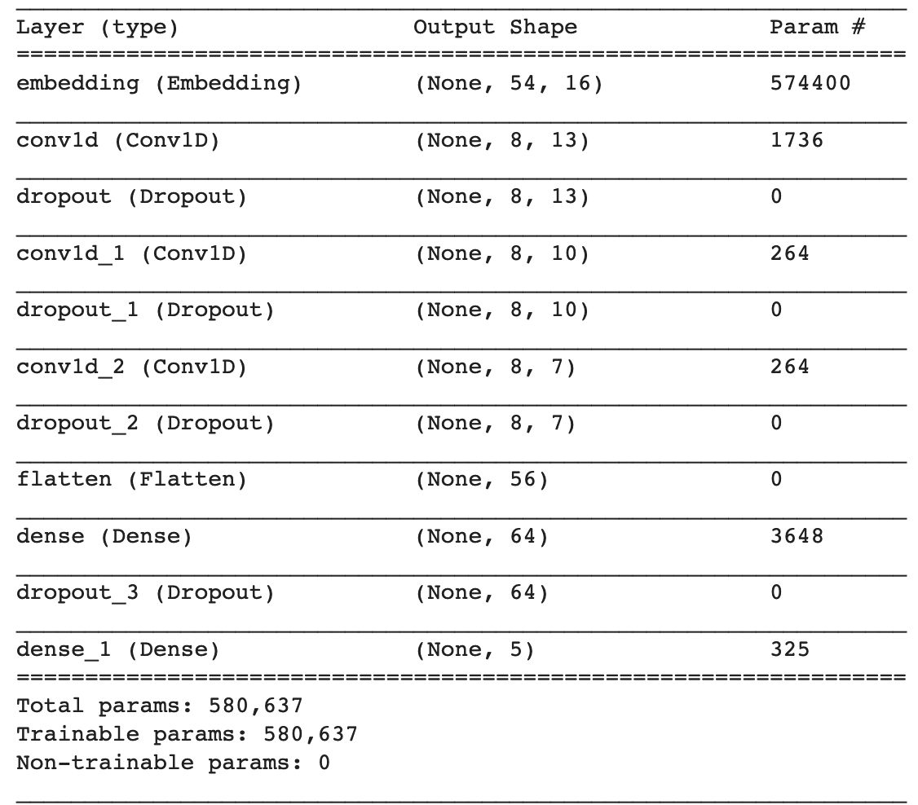
Convolution
1D convolutions, like an outer approach.
Note: Using only a few parameters except embedding layer.
Notes:
The last base model is kind of an outer approach: it applys 3 convolutional layers and a dense layer. Note that convolutional layers only need a few parameters, so this model adds only a few extra parameters.It’s even smaller than the base model.
~~~ Next

Slide 12
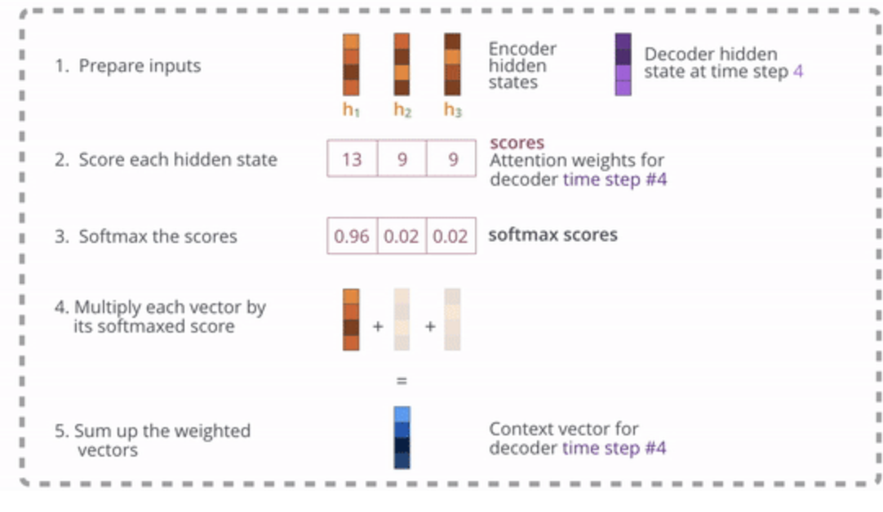
Advanced Model: Bert
Attention layer:
For encoder-decoder architecture, encoder is not providing the hidden state of the last node. It provides all hidden states to the decoder and the decoder chooses the most important one.
Notes:
Now I’ll talk about an advanced model: Bert.
First we need to the attention layer.
For encoder-decoder architecture, encoder now is not providing only the last hidden state, it provides all hidden state to the decoder.
Attention tries to find which hidden state is the most import state and make its weight bigger.
In this picture, first we can see three hidden states, decoder will score them and compute a softmax score.And calculate a weighted sum as the context vector.
~~~ Next

Slide 13
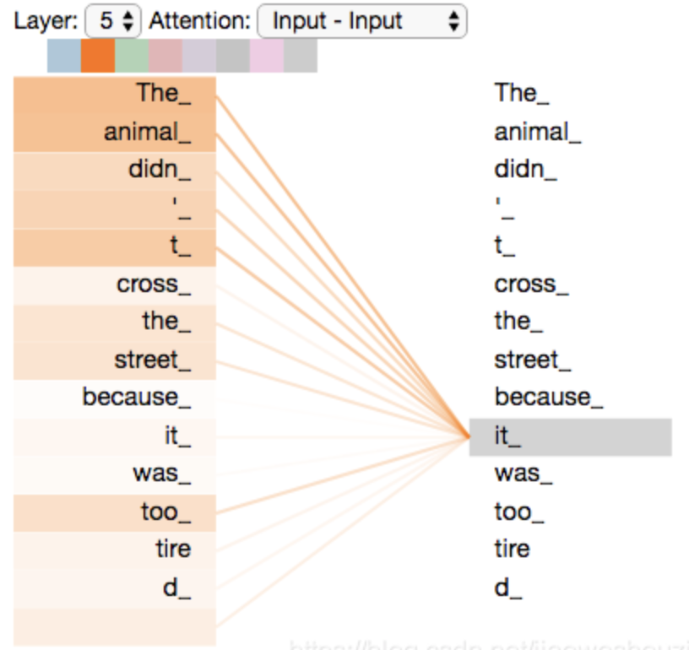
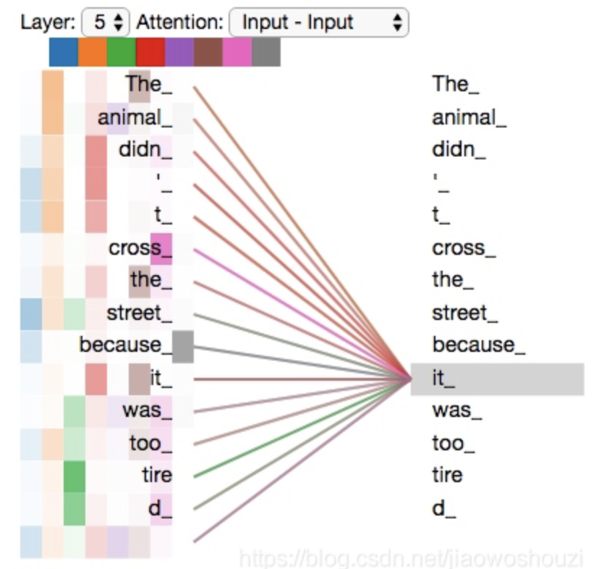
Advanced Model: Bert
Self-Attention
Notes:
Bert uses attention layer do self attention.
Self attention is doing attention with itself.
For example.Let’s look at the sentence:’The animal didn’t cross the street because it was too tired”.
What does the word ‘it’ mean? For human beings, it is easy to find ‘it’ in this sentence means the animal.But our model may not know. So we apply a self attention to give it the ability to find what does the word ‘it’ really mean. The picture on the left-side shows one attention matrix. The animal has the biggest weights and the street is smaller. The picture in the right shows multi-head attention.It generate 8 attention matrix and the have different weights like the green one finds ‘tired’ was the most important thing.

Slide 14
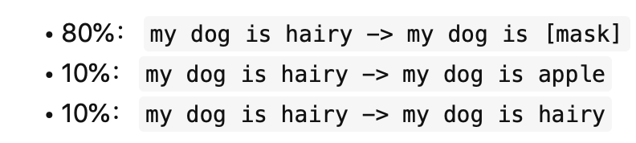
Advanced Model: Bert
Pretrained tasks
1.Masked language model.
Try to predict the original word.
2. Next Sentence Prediction: Determine whether sentence B is the following sentence of sentence A
Notes:
And bert model already did some pretraining in some tasks.
The first task is masked language model. This task replace a word in a sentence with a mask or a random word and try to predict the original word using bert.
The second task is next sentence prediction. It trys to determine whether sentence B is the following sentence of sentence A.
~~~ Next

Slide 15
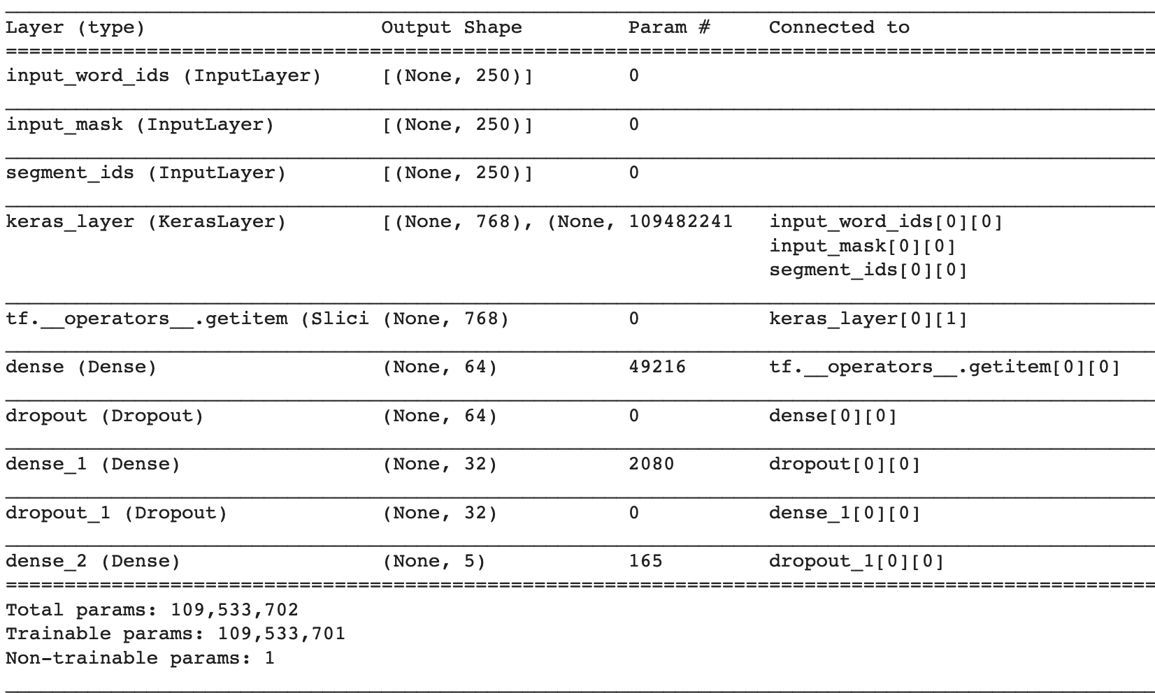
Advanced Model: Bert
Parameters: 110M(Bert), only a few parameters for the dense layers.
Notes:
This shows the model structure.
The main part is bert encoding part. It has about 110 millions parameters.Besides that, we only add two small dense layers.

Slide 16
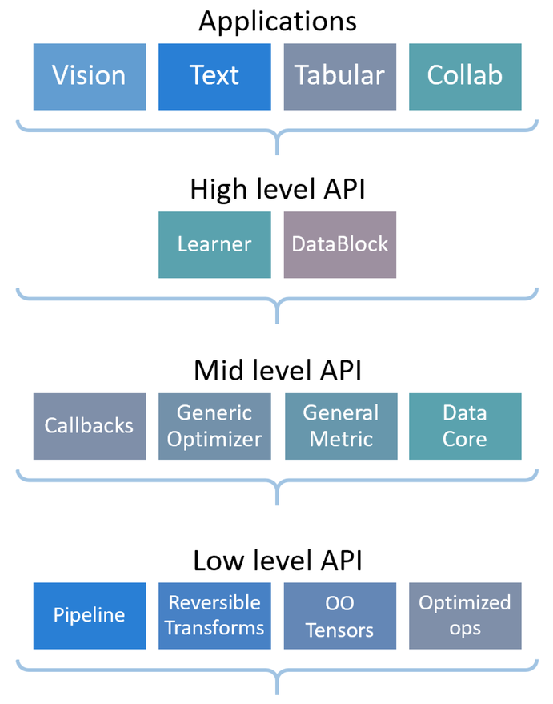
Advanced Model: Fastai
Fastai is a deep learning library, with a carefully layered architecture, that allows to mix and match the low-level components of the neural networks to build new approaches that have state-of-the-art results in standard deep learning domains.

Slide 17
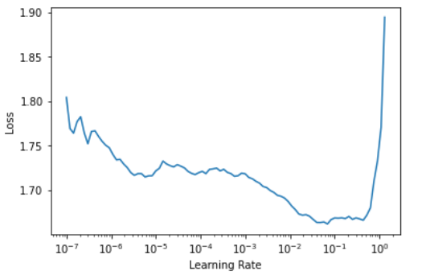
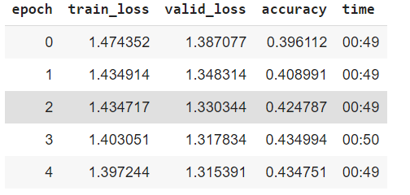

Advanced Model: Fastai

Slide 18
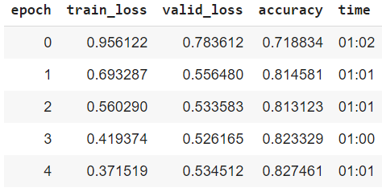
Advanced Model: Fastai

Slide 19
Evaluation
Model | Precision Recall | F1-Score | Accuracy in %
Feedforward neural network | 0.68 0.65 | 0.65 | 65
Bidirectional LSTM | 0.76 0.75 | 0.76 | 75
Convolution layers + Dense layers | 0.68 0.67 | 0.68 | 67
Bert | 0.85 0.84 | 0.84 | 84
FastAI | 0.84 0.83 | 0.83 | 83

Slide 20
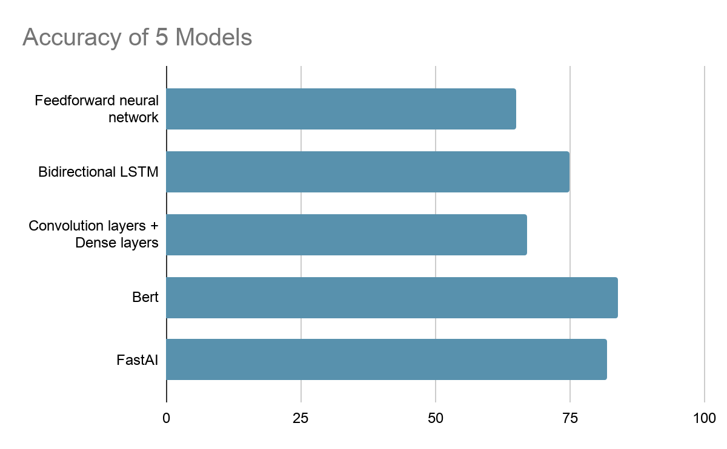
Evaluation

Slide 21
Further Studies
Semantic Analysis & Syntactic Analysis
Utilize our pre-trained model to work on other covid-related data

Slide 22
Q&A

